Slide 1
BIG DATA PROJECT
Spark and Tableau
Roni Sheffi
Rotem Singer

Slide 2
Creating a tabular model in the star scheme
The star scheme includes 3 tables: Fact_ratings (based on BX-Book-Rating.csv), Dim_books (based on BX-Books.csv) and Dim_users (based on BX-Users.csv)

Slide 3
Fact_ratings
After reading the .csv file, all irrelevant columns were dropped (only “User-ID;”, “ISBN” and “Book-Rating” remained)
The “User-ID;” column was renamed “UserBK” and the “ISBN” column was renamed “BookBK”
Rows with null values were dropped
The “;” character which appeared in the “UserBK” column was dropped
The data type in the “UserBK” and “Book-Rating” column was changed from string to int
All rows where the BookBK length (the typical length) isn’t 10 were dropped
All rows where BookBK included spaces or dots (illegal values) were dropped
A “RatingSK” surrogate key column was added

Slide 4
Dim_books
After reading the .csv file, the “Image-URL-S”, “Image-URL-M” and “Image-URL-L” column were dropped because they are not relevant to the analysis
The “ISBN” column was renamed “BookBK”
All rows where the year of publication was after 2004 were dropped (the file was composed in 2004)
All rows where the publication year was 0 were dropped (because these books weren’t really published in year 0)
All rows where the BookBK length (the typical length) isn’t 10 were dropped
All duplicate rows were dropped
All rows where the book author’s name included “\” were dropped
A “BookSK” surrogate key column was added

Slide 5
Dim_users
The “User-ID” column was renamed “UserBK”
All rows with null values were dropped
The data type in the “UserBK” and “Age” column was changed from string to int
The “Age” column had many null values which were replaced by -1 using the fillna() method. The cost of this was to not make any calculated columns or analysis based on the “Age” column since it is flawed
All rows where the age was not between 10 and 100 were dropped (except -1) since it doesn’t make sense to have these ages of users who rated books

Slide 6
Dim_users
The “Location” column was split into 3 columns: “City”, “Region” and “Country” by the “,” character which separated them in the original column which then got dropped
In the “Country” column, all “usa” values were replaced by “united states” because later on the term “united states” appears in the countries DataFrame which was created
All rows where either the “City”, “Region” or “Country” columns were an empty string were dropped
All rows where the “City”, “Region” or “Country” column contained numeric values were dropped
All rows where the “City” or “Region” column were “n/a” were dropped
All rows where the “City”, “Region” or “Country” column contained special characters (-?.”(*&<>~|/_#!) were dropped

Slide 7
Dim_users
The “pycountry” Python library was installed
A countries DataFrame was created based on the information from the “pycountry” library with lowercase country names
The Dim_users and countries DataFrames were joined on countries columns equality (inner join) in order to drop rows where the country value was illegal
A “UserSK” surrogate key column was added

Slide 8
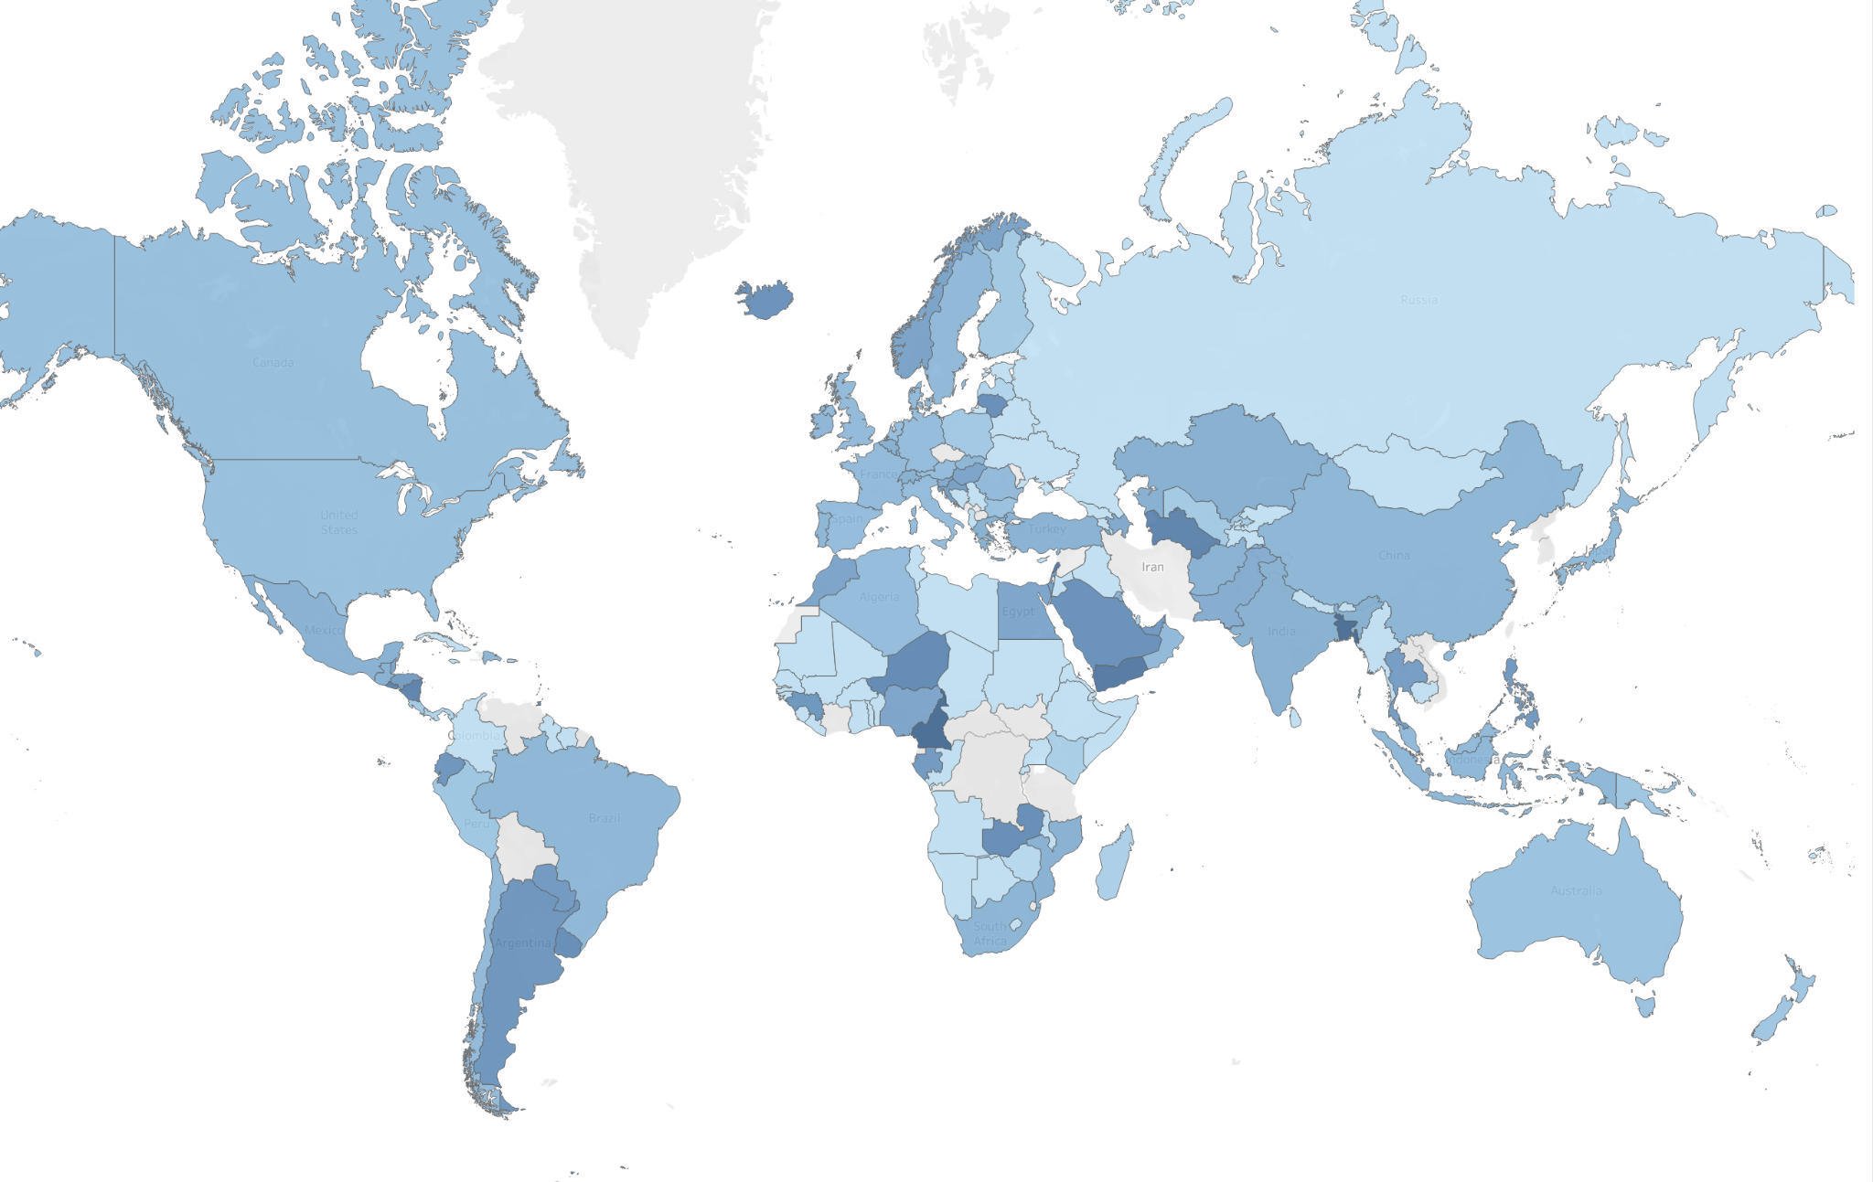
Analysis in Tableau
World map - Average rating by country

Slide 9
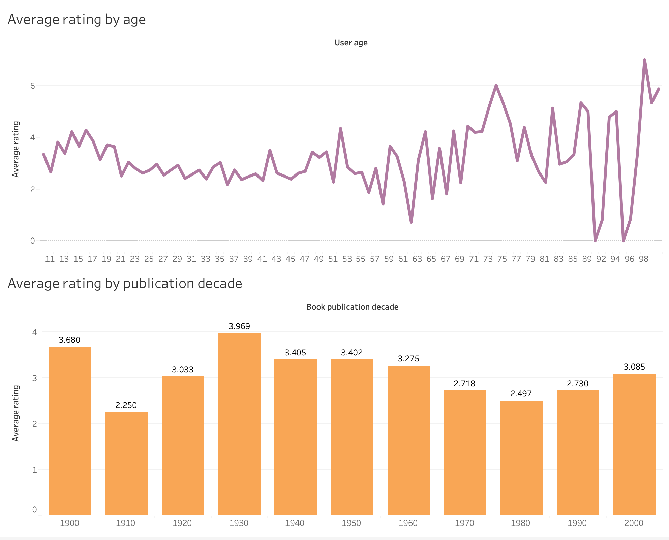
Analysis in Tableau
Average rating by age - in older ages there are many “ups and downs”
Average rating by publication decade - books from the 1930’s had the highest rating

Slide 10
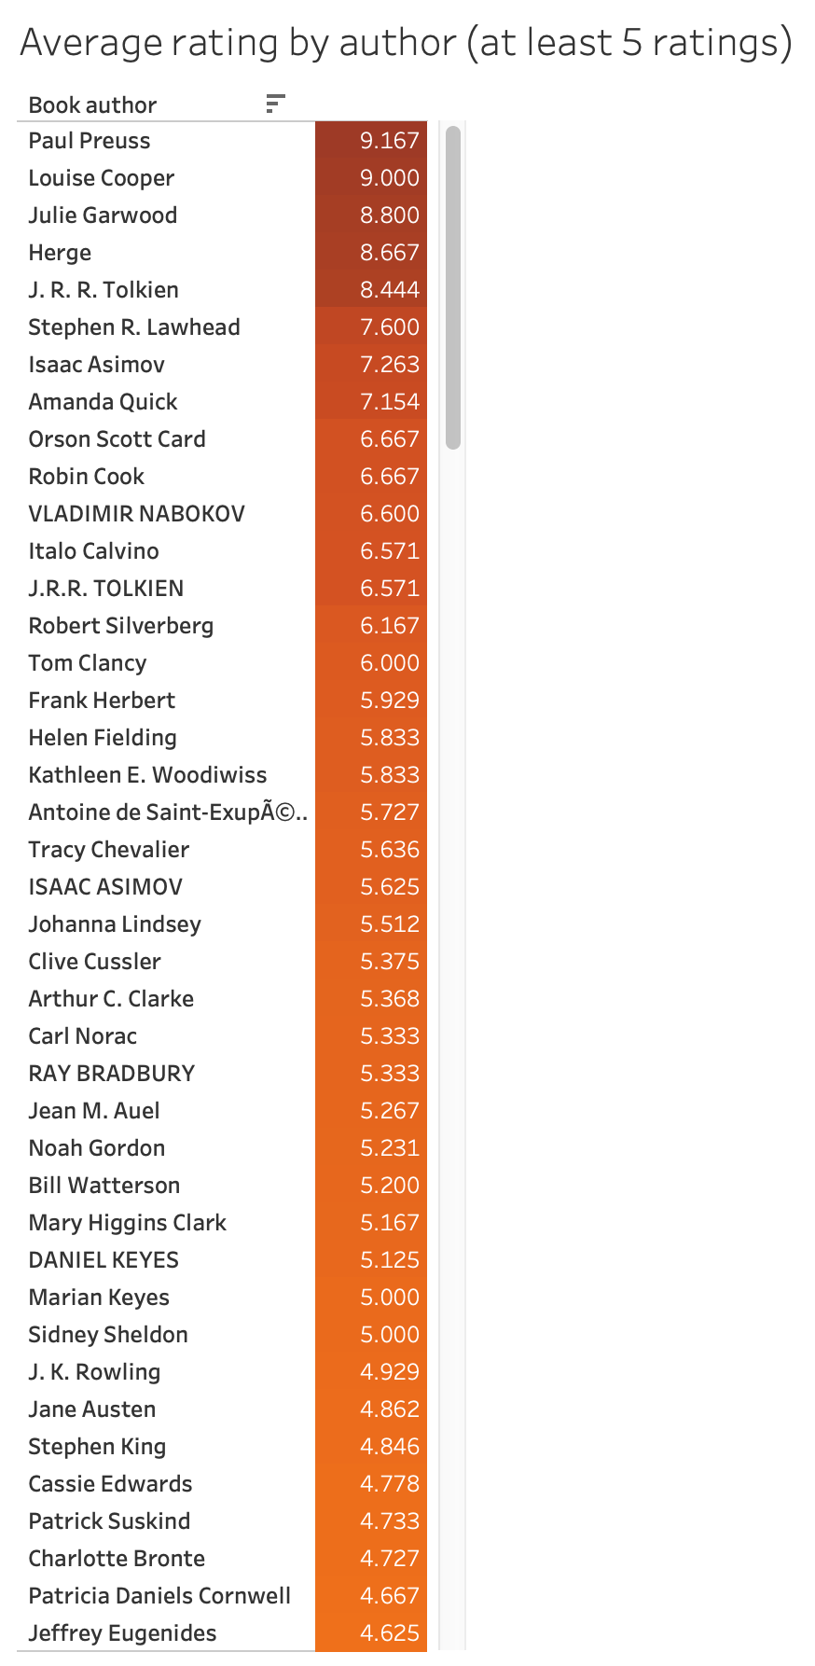


Analysis in Tableau
Average rating by author (with at least 5 ratings) - Paul Preuss the is best rated author

Slide 11
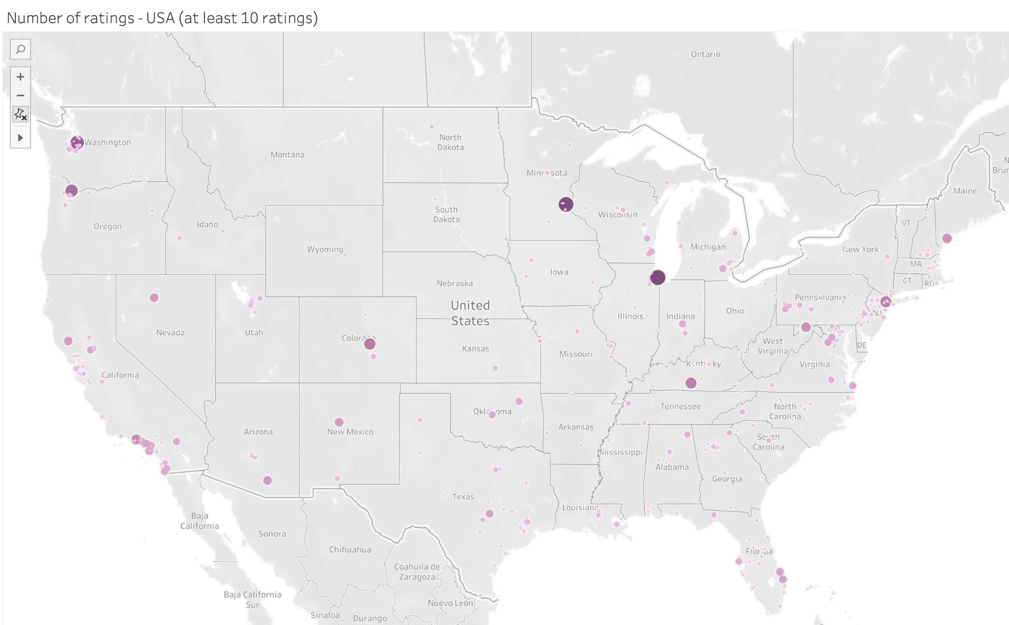
Analysis in Tableau
U.S. cities by number of ratings - Chicago has the most ratings, but maybe in other big cities they counted some neighboring cities too…

